Slide 1
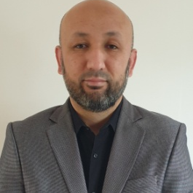

Omerjan
Memetimin
Email omerjan.k@gmail.com
Phone number 0628750527
data analyst startup
Location Kortenhoef , Noord Holland
Professional
Taxi Driver
Academic
Vrije University Amsterdam
Bachelor's degree, International Business Administration
新疆大学
Xin Jiang University
Information technology
september 2015 — present day | Ehsan Tours
Role/project description
Main responsibility owner
Main responsibility Taxi driver
Main responsibility 3
2011 — 2013 | Post.nl
Role/project description
Main responsibility Mail delivery,
Main responsibility 2
Main responsibility 3
Taxi driver
Mail delivery
Xxx
xxx
Vice President
Uyghur Revival Association
IBM Data Science
Server-side Development with NodeJS, Express and MongoDB
Front-End Web Development with React

